Slide 1
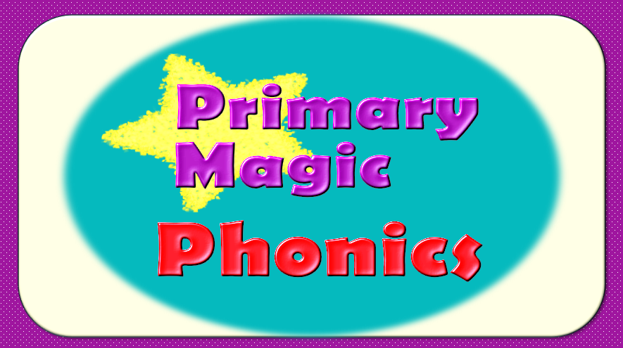

Slide 2
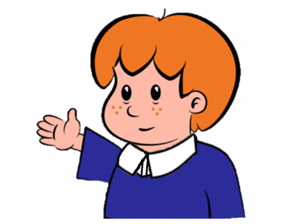
Welcome to
Primary Magic Phonics!
Today we are learning…
s
Welcome to
Primary Magic Phonics!
Today we are learning…
g

Slide 3
But first…
Can you say the phoneme for each of these graphemes?

Slide 4
p

Slide 5
a

Slide 6
n

Slide 7
d

Slide 8
i

Slide 9
m

Slide 10
Now for today’s learning.
You will see the grapheme and hear the phoneme.
Are you ready?

Slide 11
g

Slide 12
Which word begins with ‘g’?

Slide 13
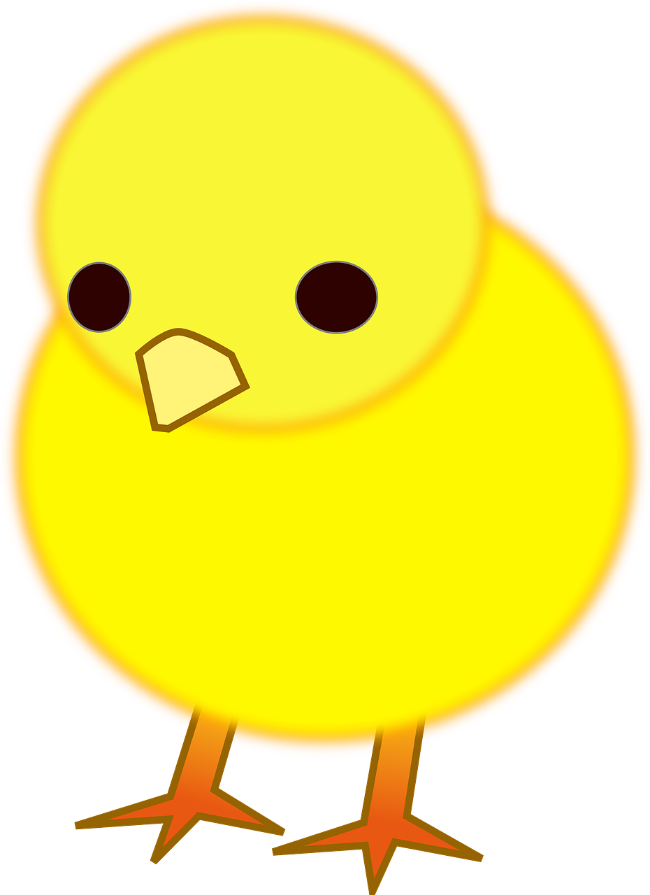
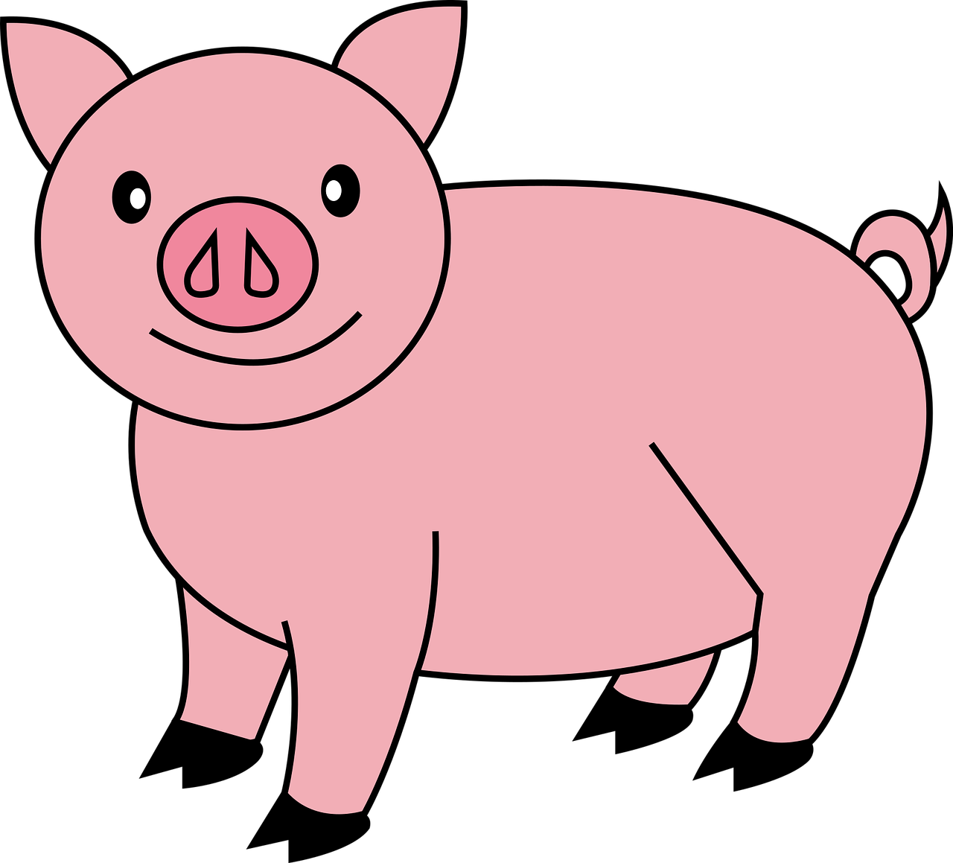
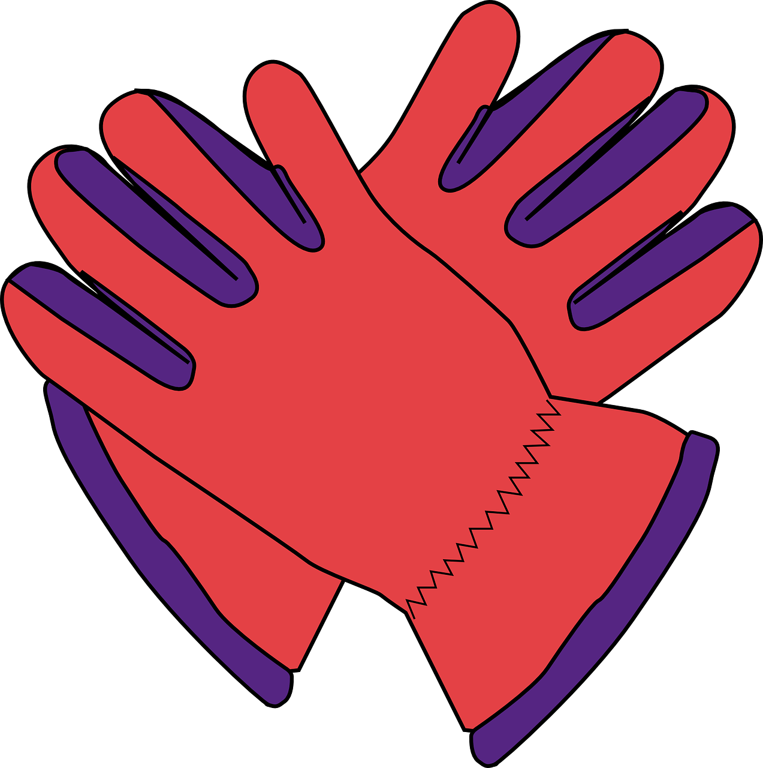
Click on the picture that begins with
g

Slide 14
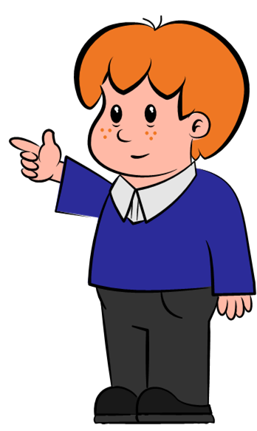
Can you write g in the air?

Slide 15
g

Slide 16
Can you write g on your whiteboard?

Slide 17
g

Slide 18
Can you read and spell these words?

Slide 19
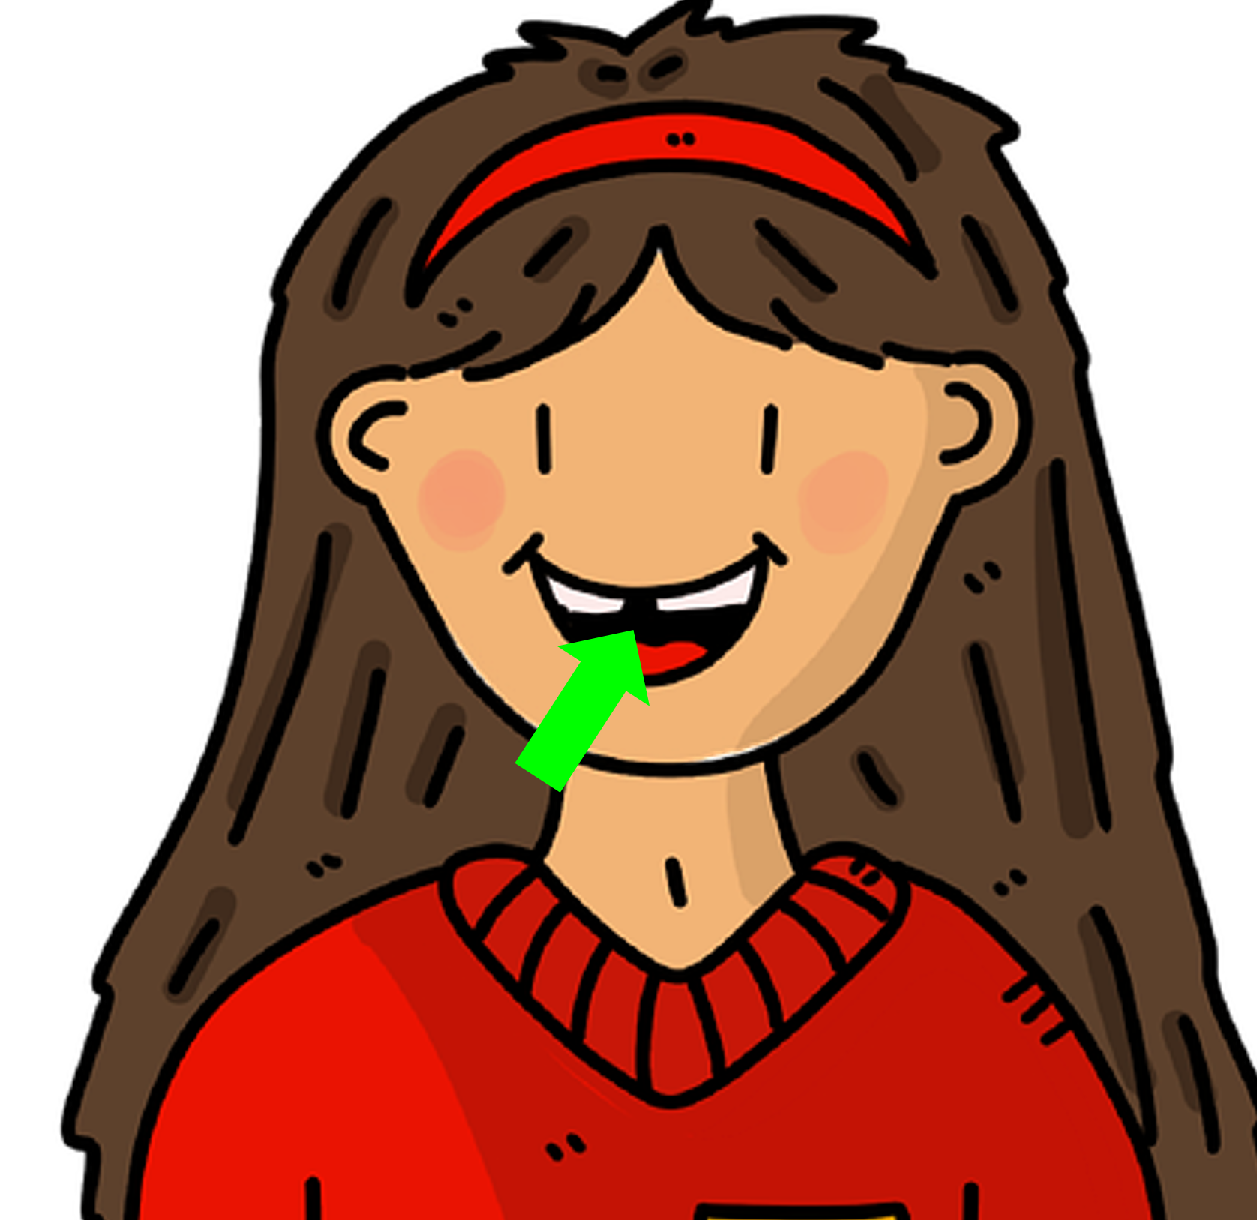
g
a
p

Slide 20
g
a
p

Slide 21
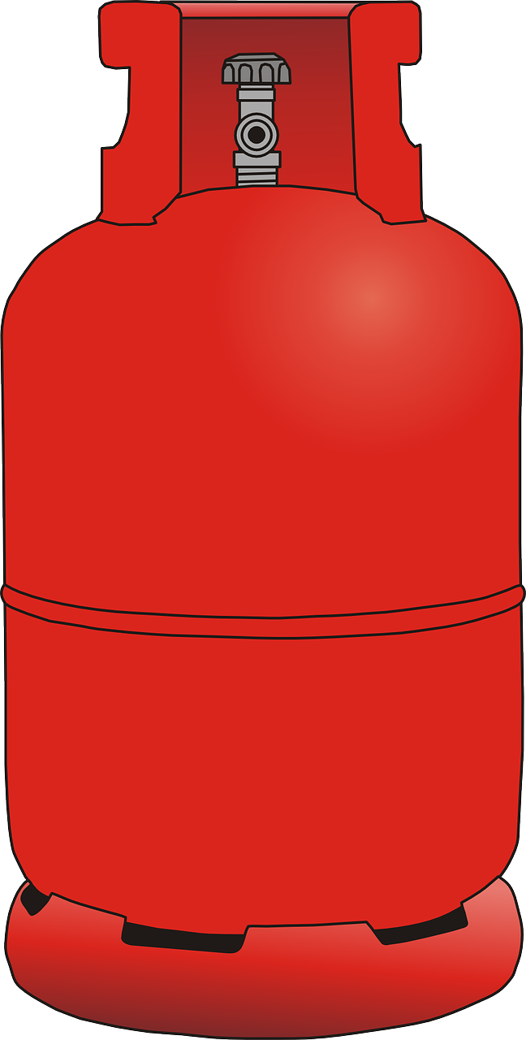
g
a
s

Slide 22
g
a
s

Slide 23
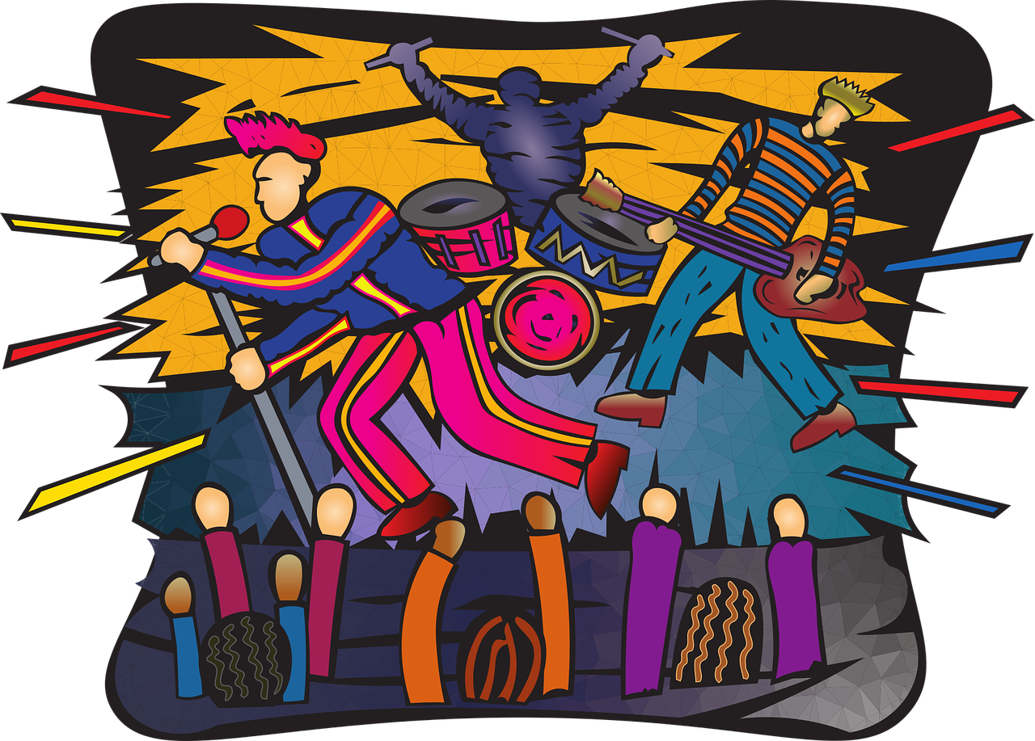
g
i
g

Slide 24
g
i
g

Slide 25
Time for a silly question! Is the answer yes or no?

Slide 26
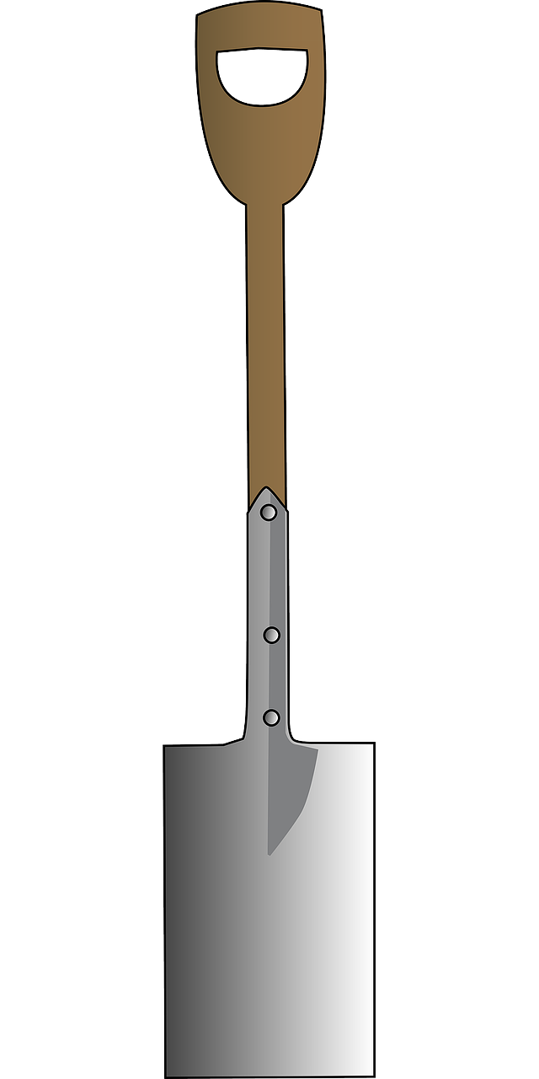
Can gas dig?
yes
no

Slide 27
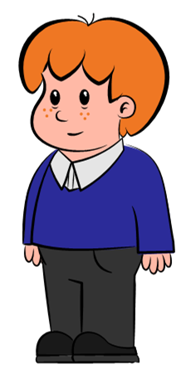
Try again

Slide 28
Fantastic work!

