Slide 1


Slide 2
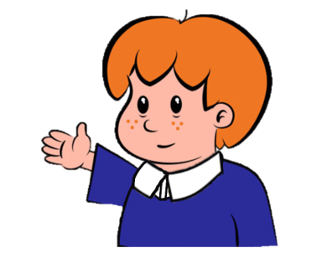

Welcome to
Primary Magic Phonics!
Today we are learning…
s
Welcome to
Primary Magic Phonics!
Today we are learning…
ai

Slide 3
But first…
Can you say the phoneme for each of these graphemes?

Slide 4

ch

Slide 5
k

Slide 6
ff

Slide 7
v

Slide 8
z

Slide 9
t

Slide 10
Now for today’s learning.
You will see the grapheme and hear the phoneme.
Are you ready?

Slide 11
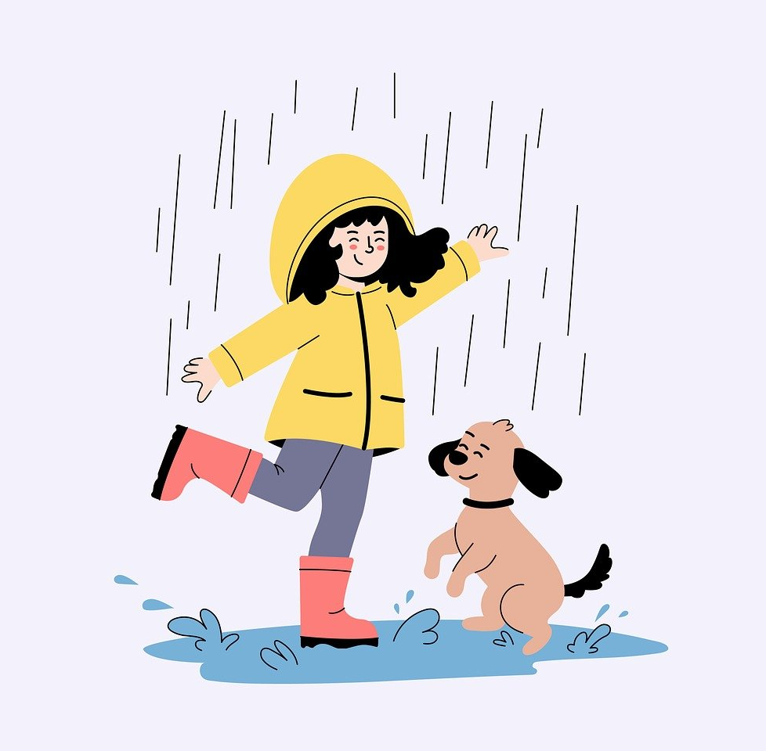
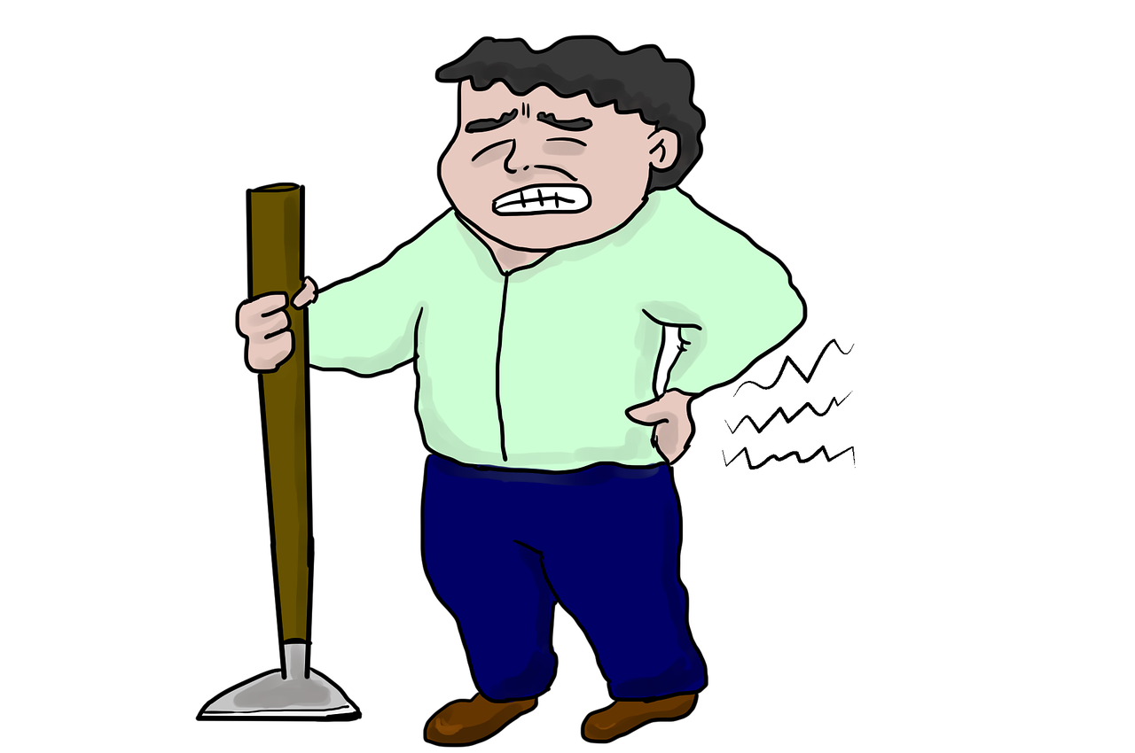

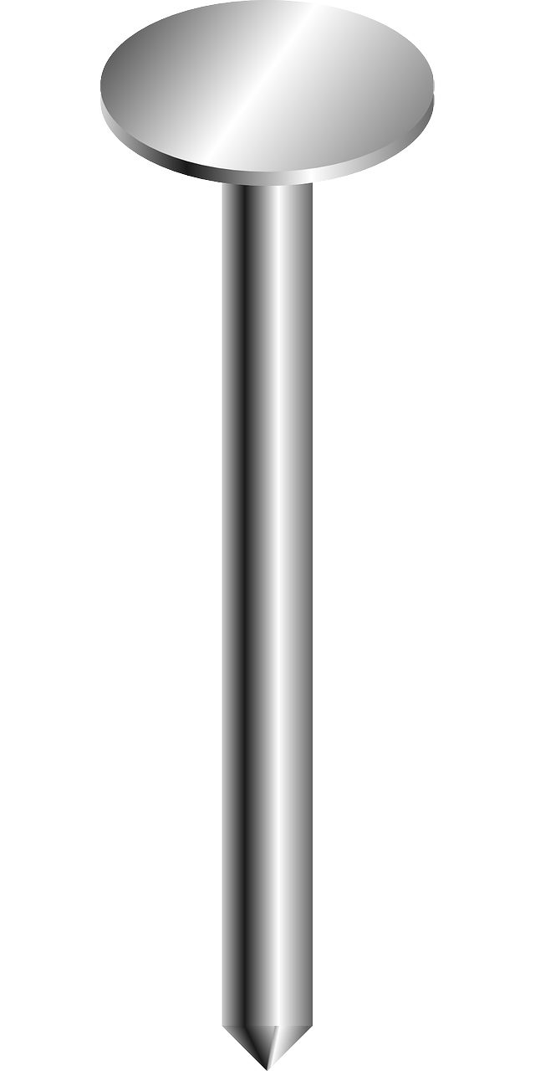
ai

Slide 12
Can you read and spell these words?

Slide 13

ch
ai
n

Slide 14
ch
ai
n

Slide 15

t
ai
l

Slide 16
t
ai
l

Slide 17
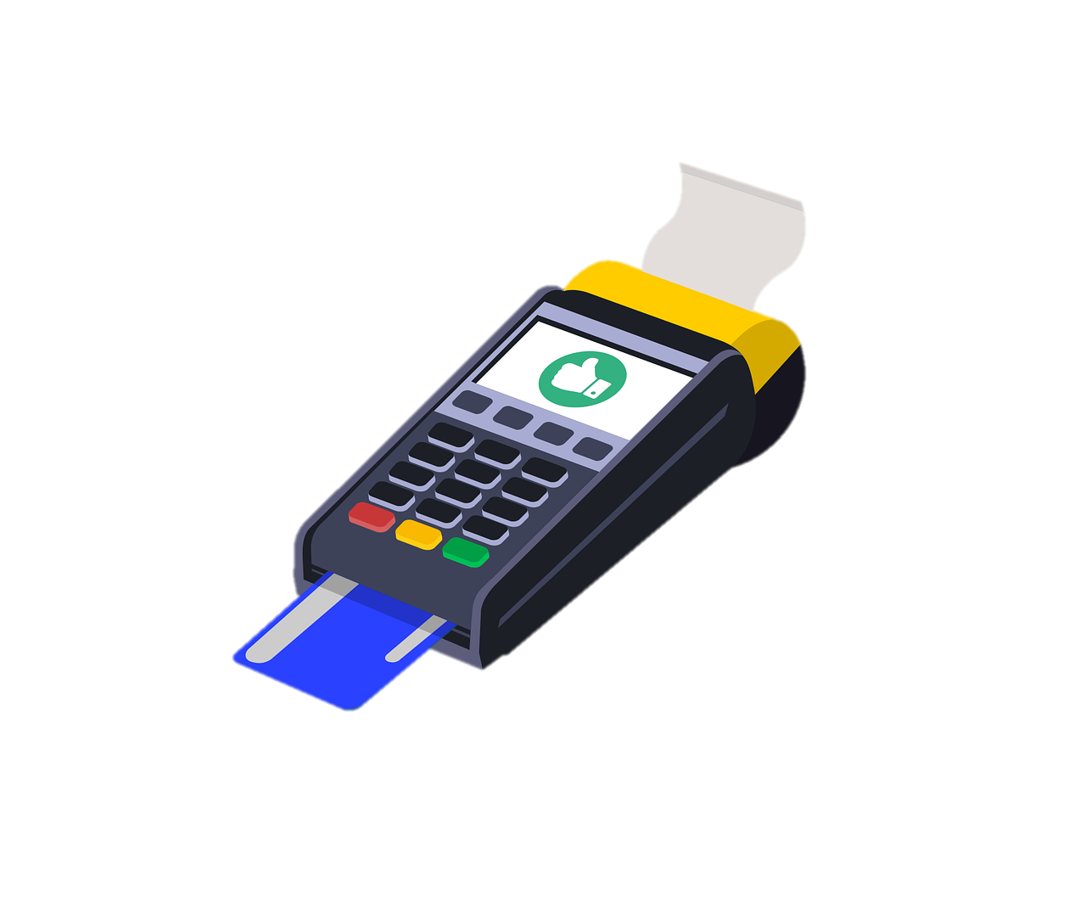
d
p
ai

Slide 18
p
ai
d

Slide 19
Can you read these words?

Slide 20
vain

Slide 21
laid

Slide 22
fail

Slide 23


This is my friend Zog. He has lost all his words and he’s really worried. Can you help us sort the real words from the alien words?
Click if the word is real.
Click if the word is alien.

Slide 24

gain
Real
Alien

Slide 25



Oh no!
?
Try again

Slide 26


gain
Next
Real
Alien

Slide 27
faib
Real
Alien

Slide 28
Oh no!
?
Try again

Slide 29
faib
Next
Real
Alien

Slide 30
hail
Real
Alien

Slide 31
Oh no!
?
Try again

Slide 32
hail
Next
Real
Alien

Slide 33
jait
Real
Alien

Slide 34
Oh no!
?
Try again

Slide 35
jait
Next
Real
Alien

Slide 36
laip
Real
Alien

Slide 37
Oh no!
?
Try again

Slide 38
laip
Next
Real
Alien

Slide 39
faith
Real
Alien

Slide 40
Oh no!
?
Try again

Slide 41
faith
End game
Real
Alien

Slide 42
Good job!
Zog is very happy you have found all his words!

Slide 43

Now let’s spell some more real words. Can you write them?

Slide 44

sail

Slide 45
wait

Slide 46
maid

Slide 47
Can you read this sentence?

Slide 48
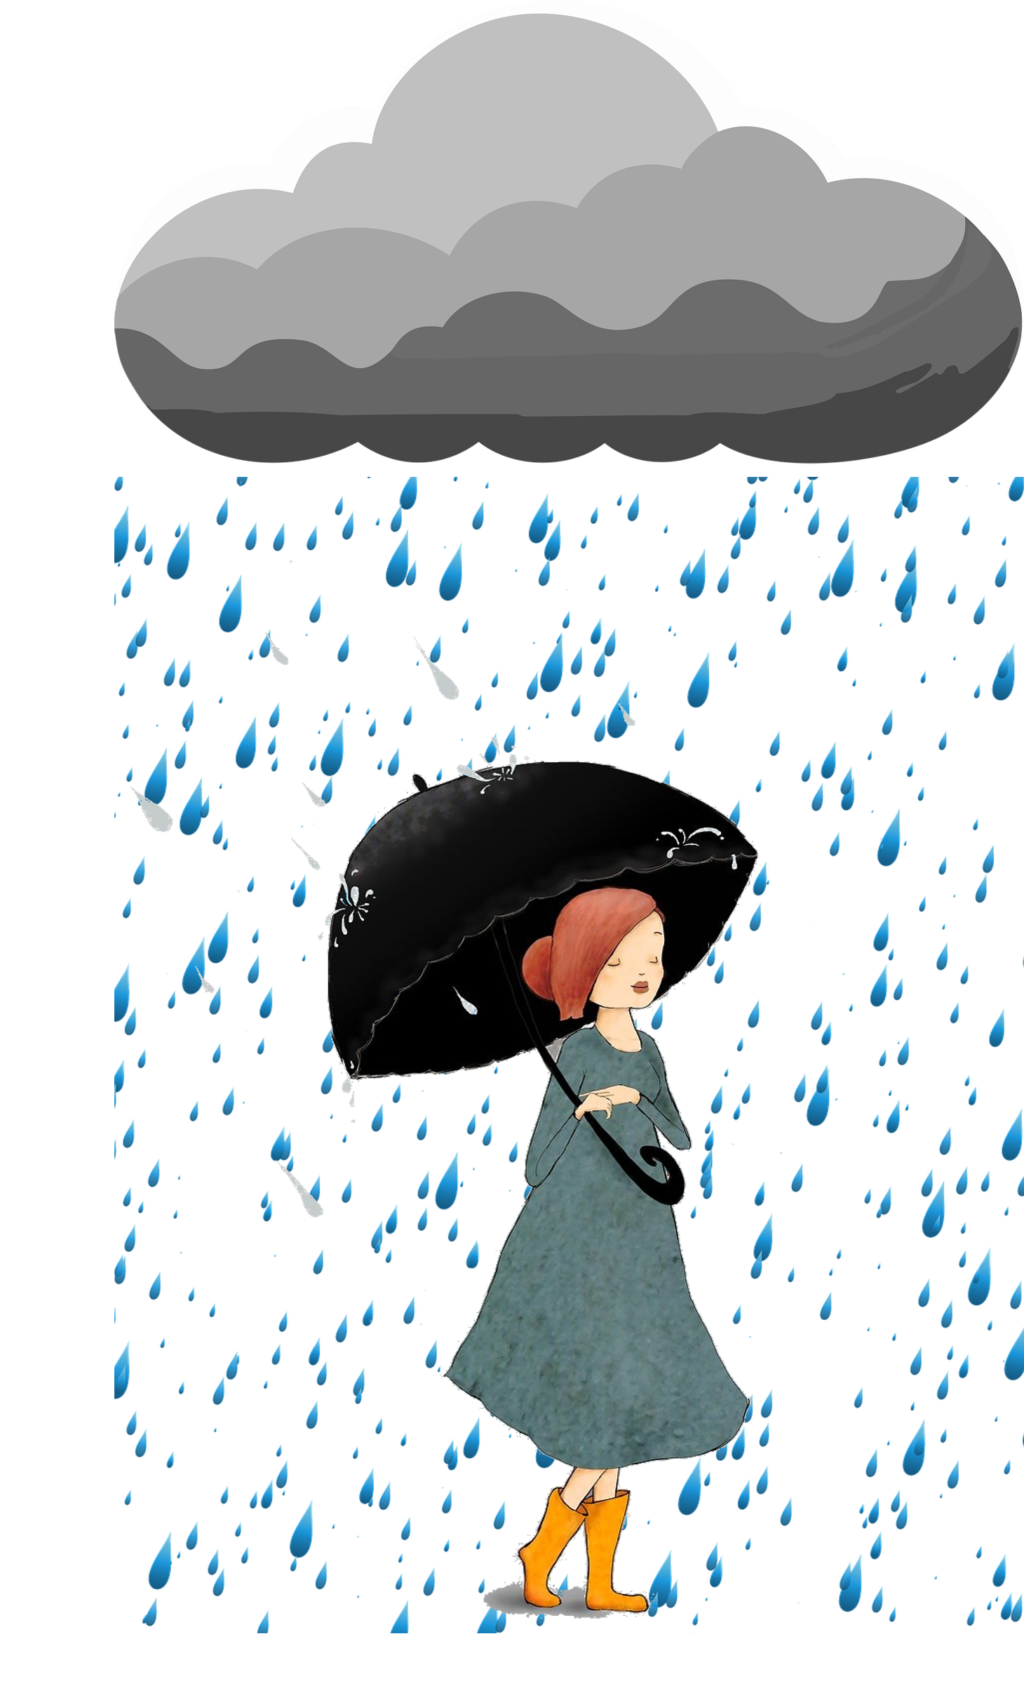
I had to wait in the rain and hail.

Slide 49
Can you write the sentence?

Slide 50
I had to wait in the rain and hail.

Slide 51

Fantastic work!

