Slide 1
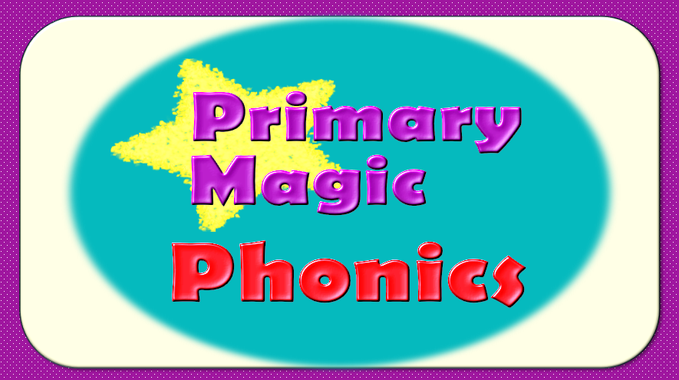

Slide 2
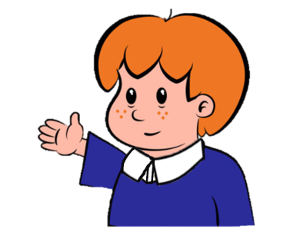

Welcome to
Primary Magic Phonics!
Today we are learning…
s
Welcome to
Primary Magic Phonics!
Today we are learning…
ch

Slide 3
But first…
Can you say the phoneme for each of these graphemes?

Slide 4

d

Slide 5
c

Slide 6
r

Slide 7
a

Slide 8
m

Slide 9
j

Slide 10
Now for today’s learning.
You will see the grapheme and hear the phoneme.
Are you ready?

Slide 11
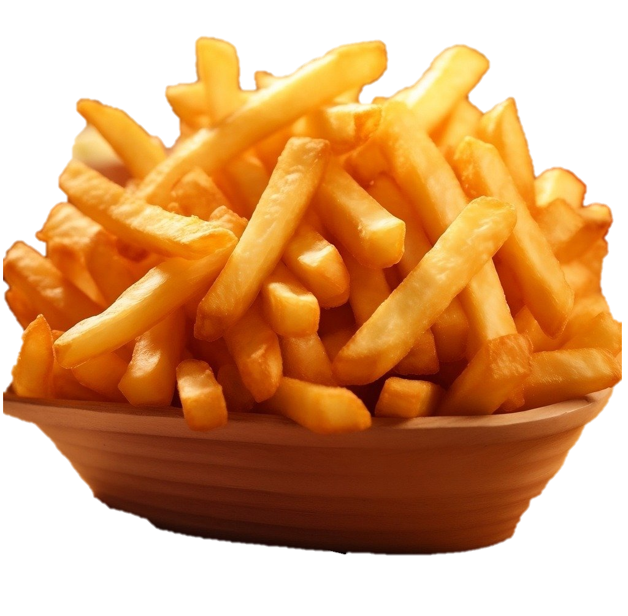

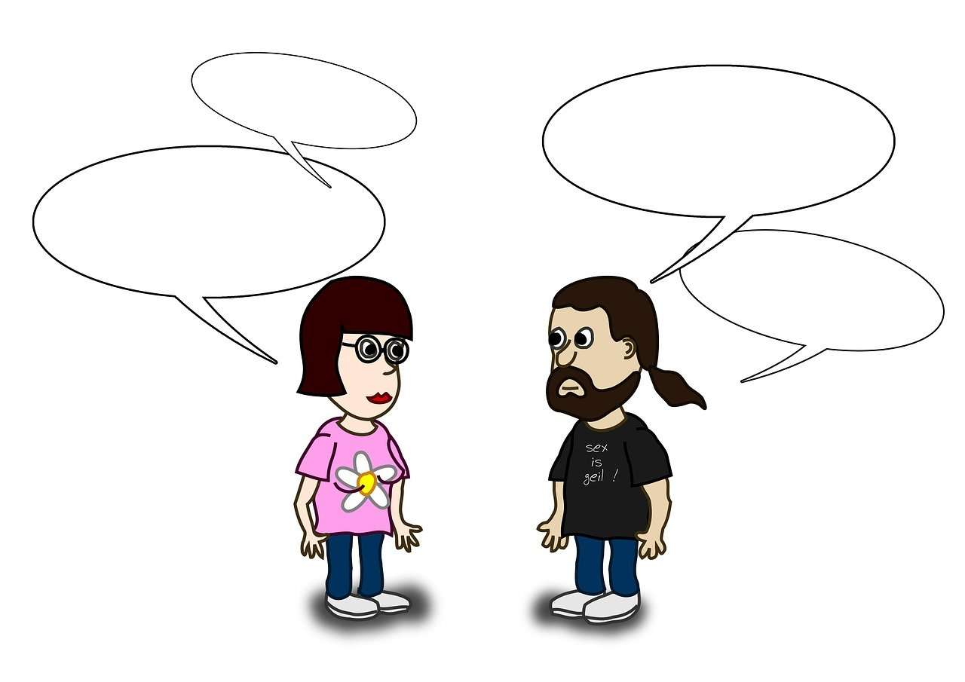
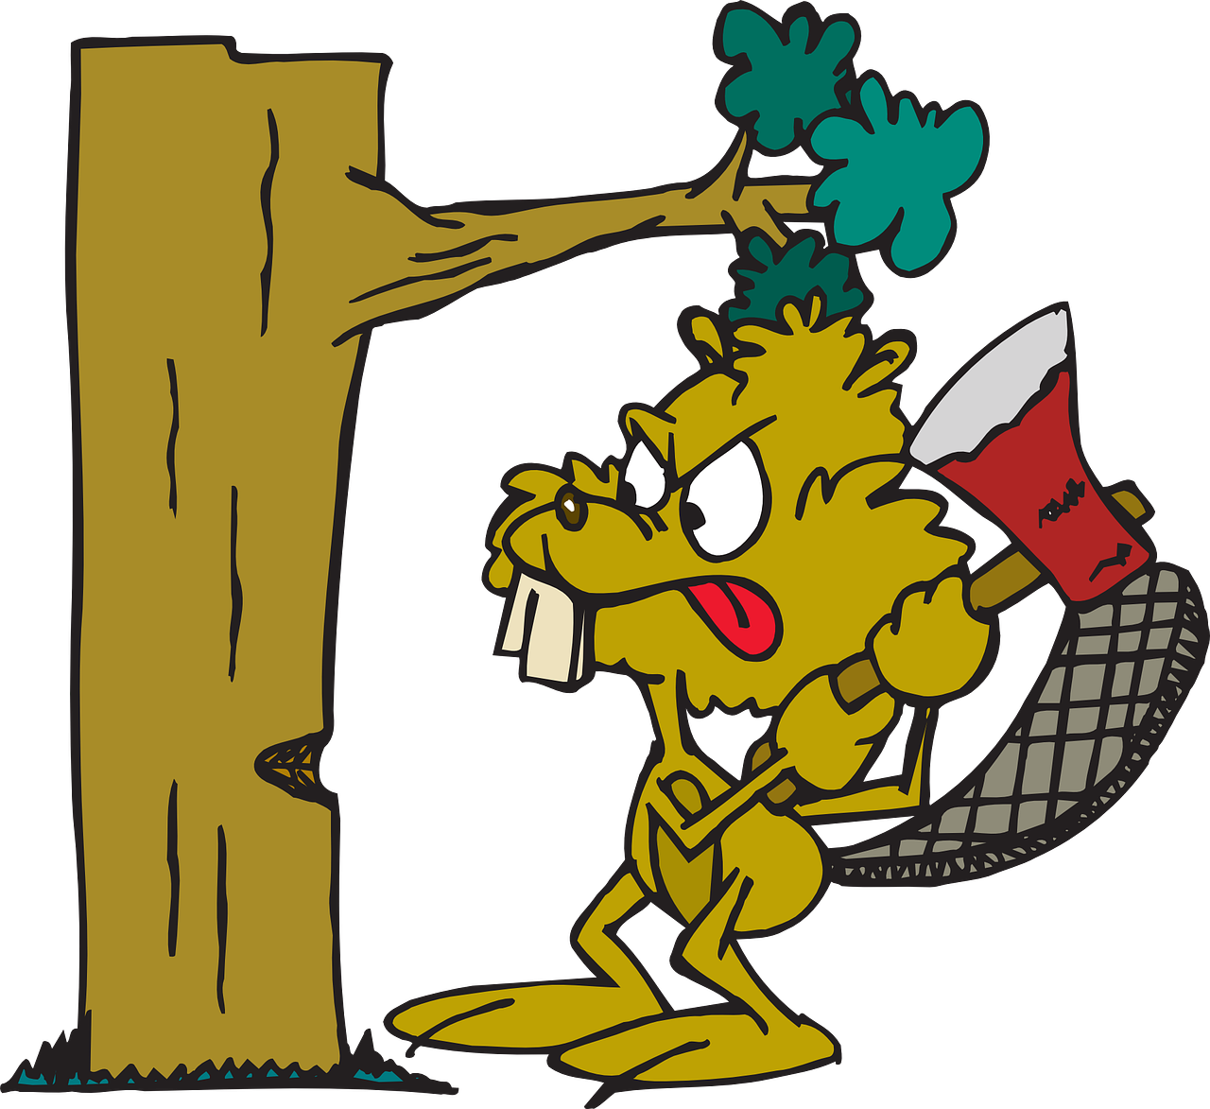
ch

Slide 12
Can you read and spell these words?

Slide 13
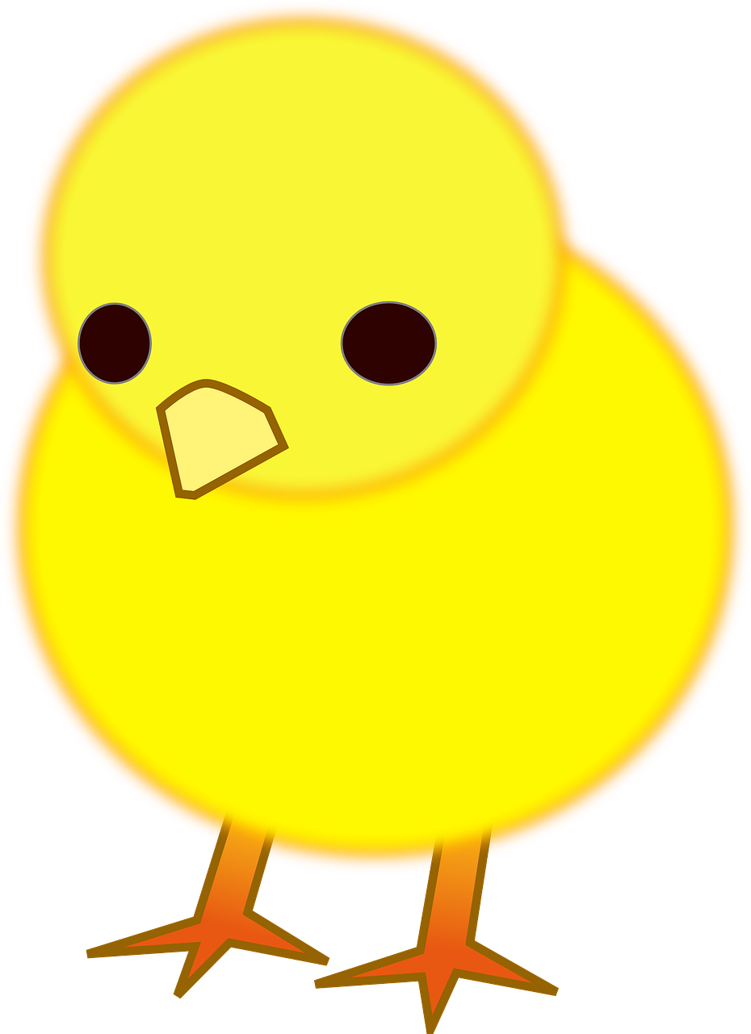
ch
i
ck

Slide 14
ch
i
ck

Slide 15
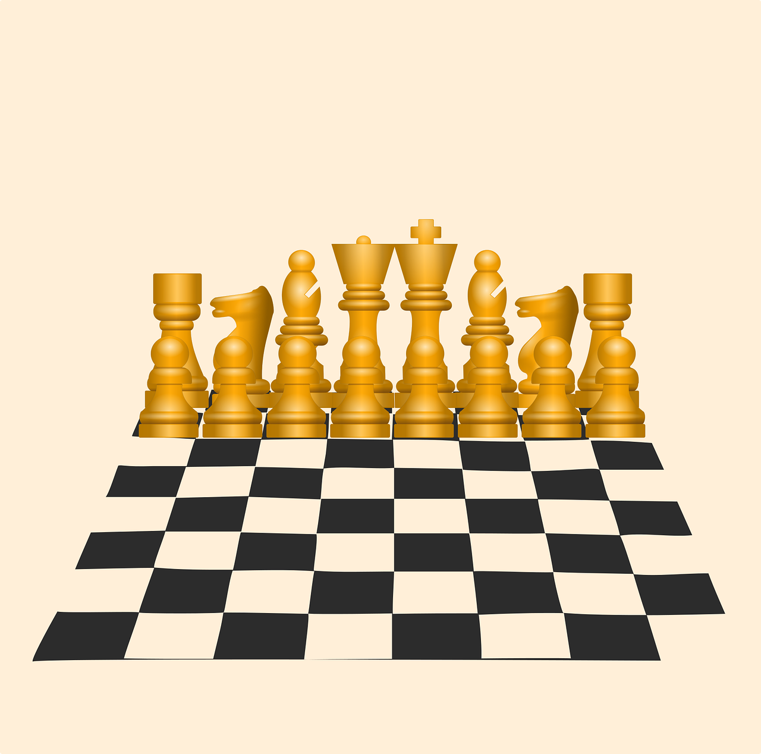
ch
e
ss

Slide 16
ch
e
ss

Slide 17
ch
a
t

Slide 18
ch
a
t

Slide 19
Can you read these words?

Slide 20
choc

Slide 21
chug

Slide 22
chap

Slide 23

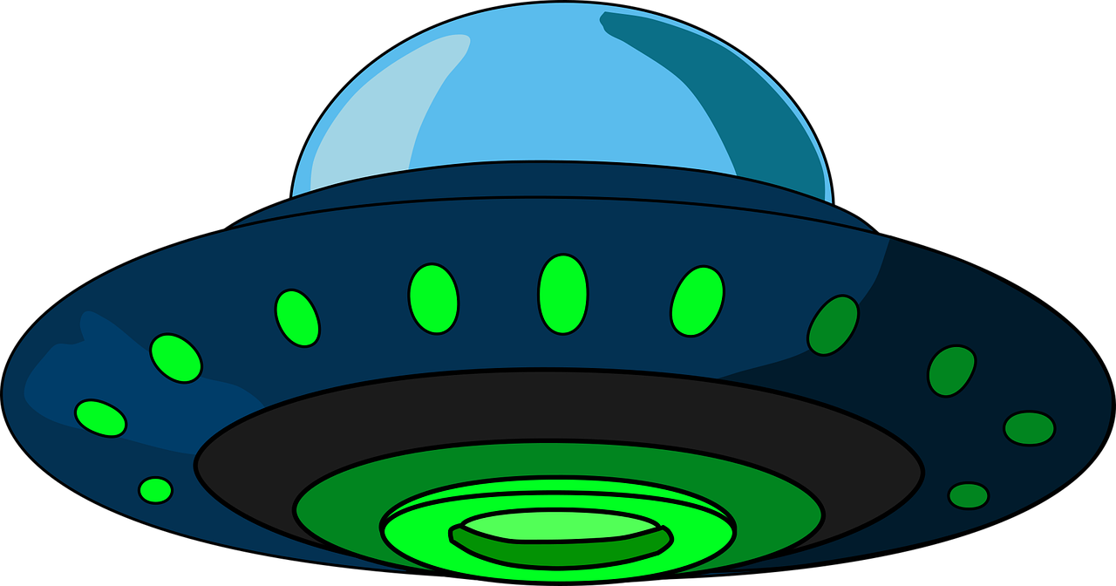
This is my friend Zog. He has lost all his words and he’s really worried. Can you help us sort the real words from the alien words?
Click if the word is real.
Click if the word is alien.

Slide 24

chip
Real
Alien

Slide 25



Oh no!
?
Try again

Slide 26


chip
Next
Real
Alien

Slide 27
cheb
Real
Alien

Slide 28
Oh no!
?
Try again

Slide 29
cheb
Next
Real
Alien

Slide 30
chill
Real
Alien

Slide 31
Oh no!
?
Try again

Slide 32
chill
Next
Real
Alien

Slide 33
chis
Real
Alien

Slide 34
Oh no!
?
Try again

Slide 35
chis
Next
Real
Alien

Slide 36
chog
Real
Alien

Slide 37
Oh no!
?
Try again

Slide 38
chog
Next
Real
Alien

Slide 39
chop
Real
Alien

Slide 40
Oh no!
?
Try again

Slide 41
chop
End game
Real
Alien

Slide 42
Good job!
Zog is very happy you have found all his words!

Slide 43

Now let’s spell some more real words. Can you write them?

Slide 44
chop

Slide 45
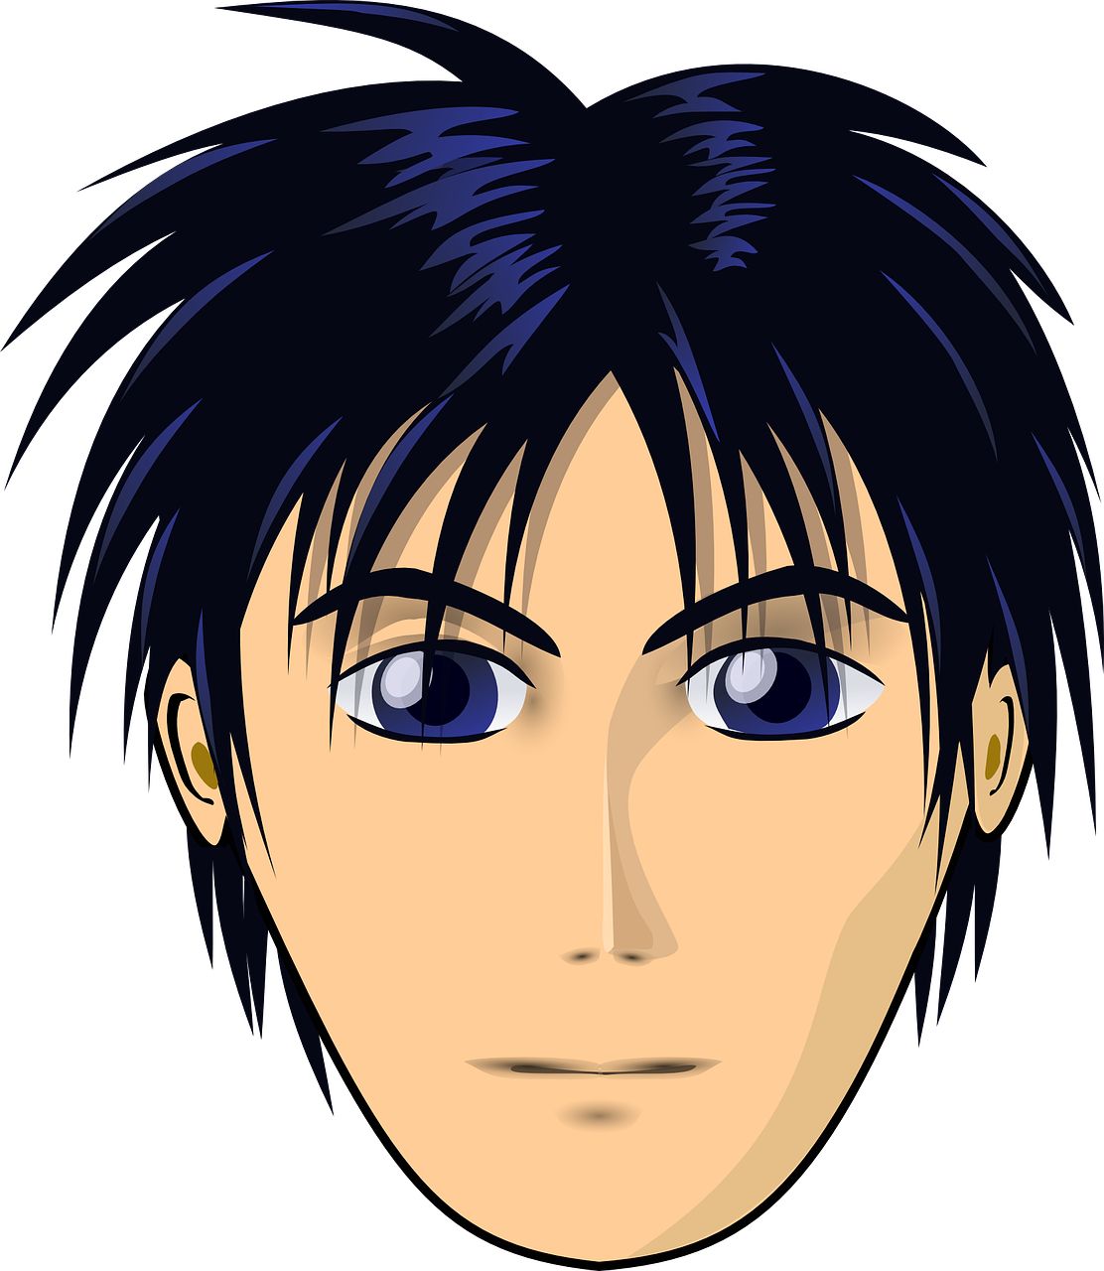
chin

Slide 46
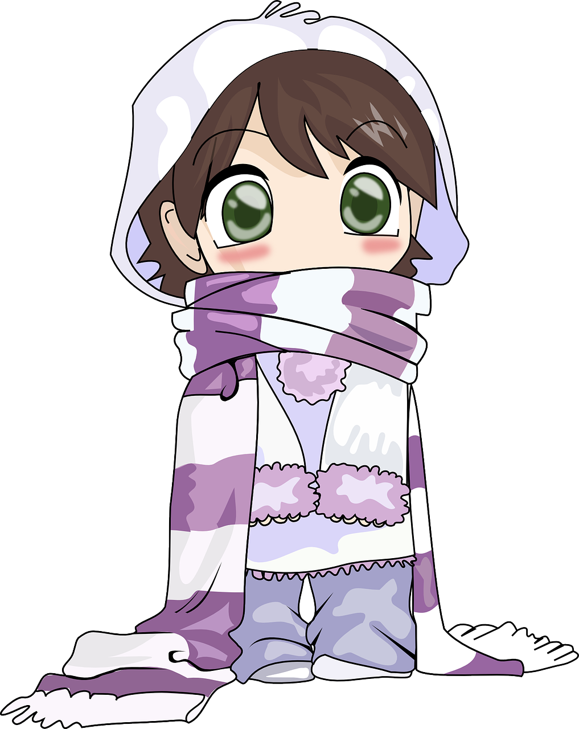
chill

Slide 47
Can you read this sentence?

Slide 48
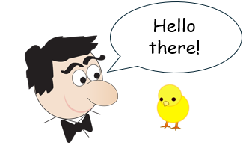
The chap chats to the chick.

Slide 49
Can you write the sentence?

Slide 50
The chap chats to the chick.

Slide 51

Fantastic work!

