Slide 2
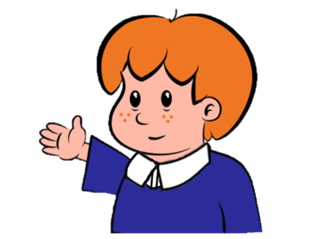
Welcome to
Primary Magic Phonics!
Today we are learning…
s
Welcome to
Primary Magic Phonics!
Today we are learning…
ck

Slide 3
But first…
Can you say the phoneme for each of these graphemes?

Slide 4
t

Slide 5
n

Slide 6
d

Slide 7
g

Slide 8
c

Slide 9
k

Slide 10
Now for today’s learning.
You will see the grapheme and hear the phoneme.
Are you ready?

Slide 11
ck

Slide 12
Which word ends with ck?

Slide 13
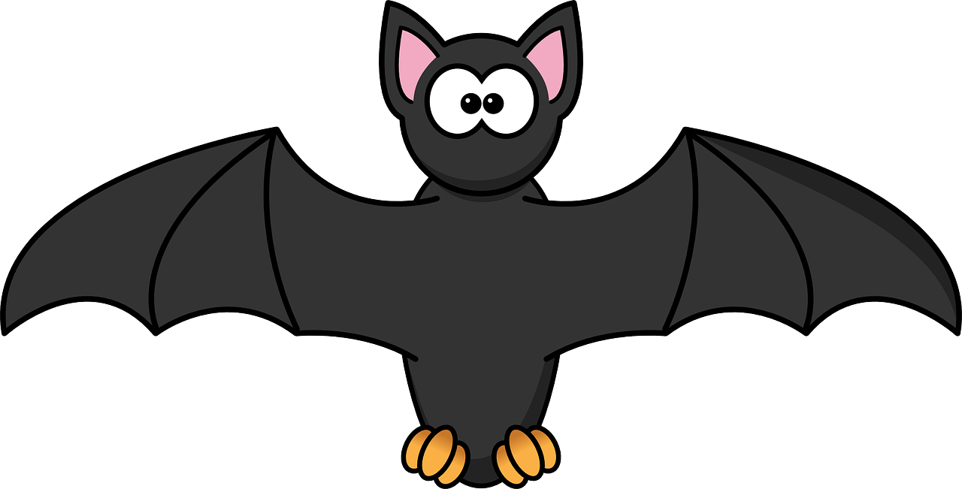
Click on the picture that ends with
ck

Slide 14
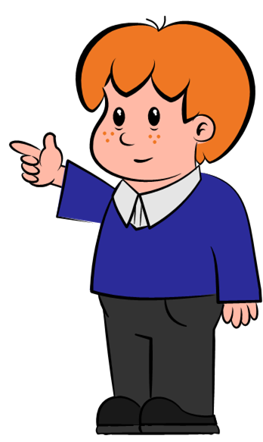
Can you write ck in the air?

Slide 15
ck

Slide 16
Can you write ck on your whiteboard?

Slide 17
ck

Slide 18
Can you read and spell these words?

Slide 19
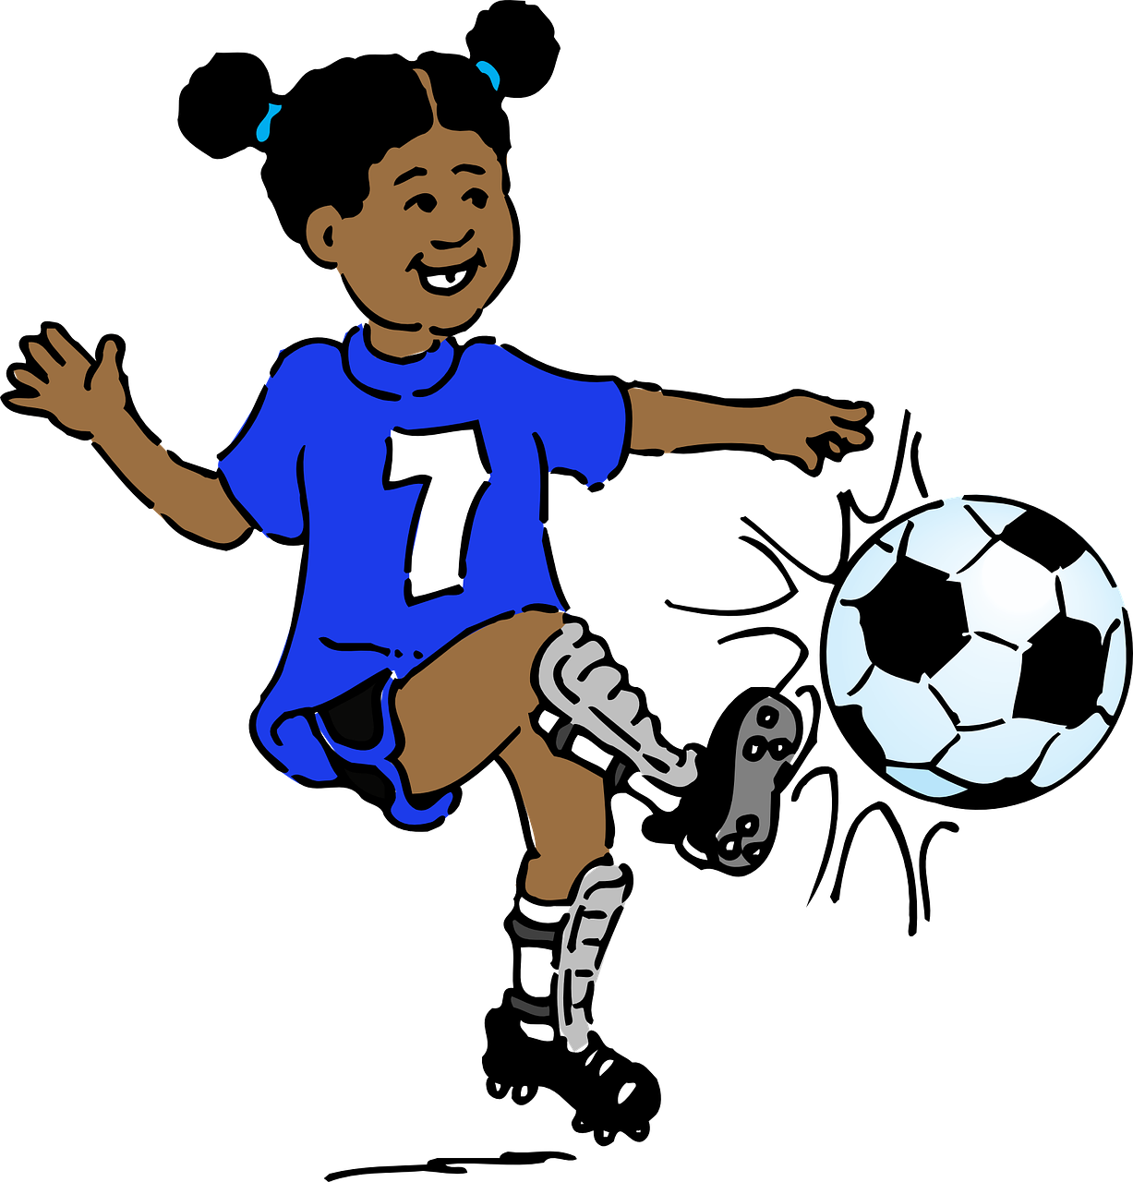
k
i
ck

Slide 20
k
i
ck

Slide 21
s
a
ck

Slide 22
s
a
ck

Slide 23
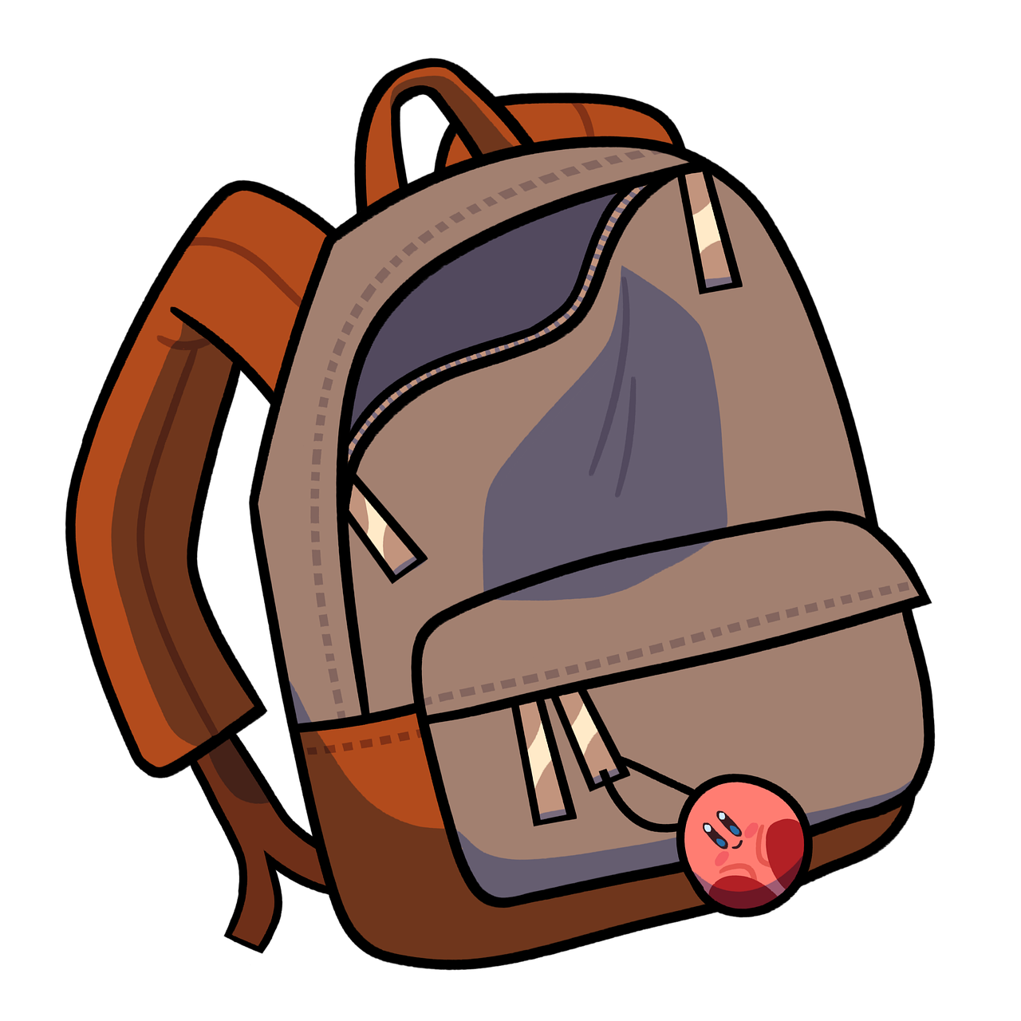
p
a
ck

Slide 24
p
a
ck

Slide 25
Time for a silly question! Is the answer yes or no?

Slide 26
Can a pack kick?
yes
no

Slide 27
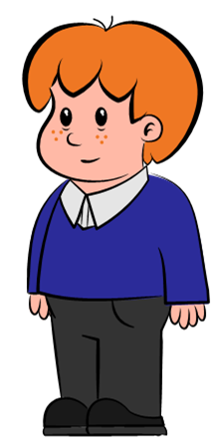
Try again

Slide 28
Fantastic work!

