Slide 1
www.primarymagic.co.uk

Slide 2
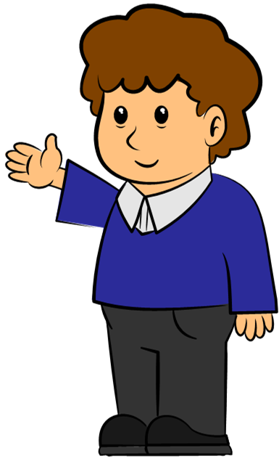
Welcome to
Primary Magic Phonics!
Today we are learning…
s
Welcome to
Primary Magic Grammar!
Today we are learning about verbs.

Slide 3
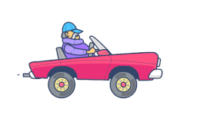
What is happening here?
Welcome to
Primary Magic Phonics!
Today we are learning…
s
The man is driving the car.
driving

Slide 4
What is happening here?
Welcome to
Primary Magic Phonics!
Today we are learning…
s
The doctor is writing on her clipboard.
writing

Slide 5
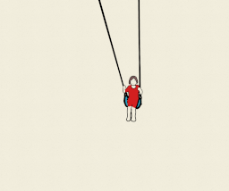
What is happening here?
Welcome to
Primary Magic Phonics!
Today we are learning…
s
swinging
The girl is swinging.

Slide 6
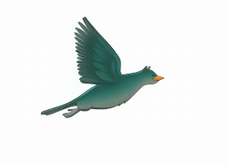
What is happening here?
Welcome to
Primary Magic Phonics!
Today we are learning…
s
flying
The bird is flying home.

Slide 7
What is happening here?
Welcome to
Primary Magic Phonics!
Today we are learning…
s
The snowman is melting.
melting

Slide 8
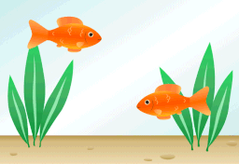
What is happening here?
Welcome to
Primary Magic Phonics!
Today we are learning…
s
The fish are swimming in the fish tank.
swimming

Slide 9
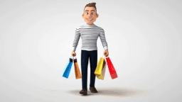
What is happening here?
Welcome to
Primary Magic Phonics!
Today we are learning…
s
The man is shopping.
shopping

Slide 10
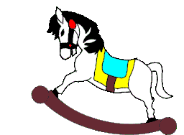
What is happening here?
Welcome to
Primary Magic Phonics!
Today we are learning…
s
The horse is rocking.
rocking

Slide 11
Welcome to
Primary Magic Phonics!
Today we are learning…
s
Can you think of a verb each of these might do?
boy
dog
teacher
friend
flower

Slide 12
Well done!

Slide 13
www.primarymagic.co.uk

