Slide 1

www.primarymagic.co.uk

Slide 2

Welcome to
Primary Magic Phonics!
Today we are learning…
s
Welcome to
Primary Magic Maths!
Today we are learning to:
Recognise odd and even numbers.

Slide 3
Welcome to
Primary Magic Phonics!
Today we are learning…
s
Hello, my name is Bella. I want to buy some cookies to share with my friend Zac. Will you help me decide how many to buy?

Slide 4
Welcome to
Primary Magic Phonics!
Today we are learning…
s
Let’s start with 1.

Slide 5



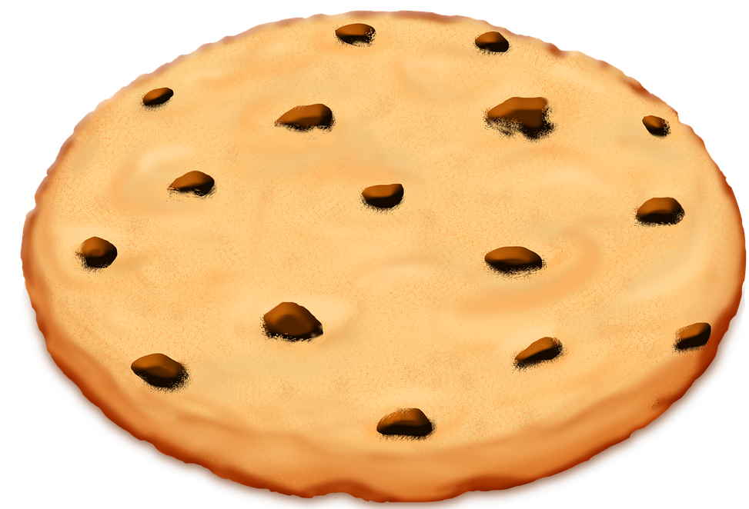


Slide 6

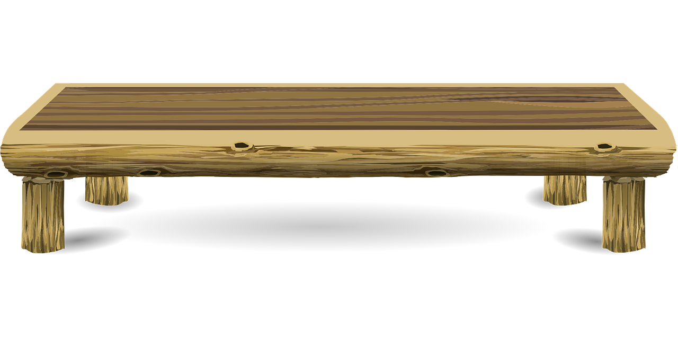

Welcome to
Primary Magic Phonics!
Today we are learning…
s
odd
1

Slide 7
Welcome to
Primary Magic Phonics!
Today we are learning…
s
Let’s try 2.

Slide 9
Welcome to
Primary Magic Phonics!
Today we are learning…
s
odd
even
1
2

Slide 10
Welcome to
Primary Magic Phonics!
Today we are learning…
s
How about 3?

Slide 12
Welcome to
Primary Magic Phonics!
Today we are learning…
s
odd
even
3
2
1

Slide 13
Welcome to
Primary Magic Phonics!
Today we are learning…
s
Let’s try 4 next.

Slide 15
Welcome to
Primary Magic Phonics!
Today we are learning…
s
odd
even
3
2
1
4

Slide 16
Welcome to
Primary Magic Phonics!
Today we are learning…
s
Now let’s try 5.

Slide 18
Welcome to
Primary Magic Phonics!
Today we are learning…
s
odd
even
3
2
1
4
5

Slide 19
Welcome to
Primary Magic Phonics!
Today we are learning…
s
Let’s try 6.

Slide 21
Welcome to
Primary Magic Phonics!
Today we are learning…
s
odd
even
3
2
6
1
4
5

Slide 22
Welcome to
Primary Magic Phonics!
Today we are learning…
s
How about 7?

Slide 24
Welcome to
Primary Magic Phonics!
Today we are learning…
s
odd
even
3
2
6
1
4
5
7

Slide 25
Welcome to
Primary Magic Phonics!
Today we are learning…
s
Let’s try 8 cookies.

Slide 27
Welcome to
Primary Magic Phonics!
Today we are learning…
s
odd
even
3
2
6
1
4
5
7
8

Slide 28
Welcome to
Primary Magic Phonics!
Today we are learning…
s
Let’s try 9.

Slide 30
Welcome to
Primary Magic Phonics!
Today we are learning…
s
odd
even
3
2
6
1
4
5
7
8
9

Slide 31
Welcome to
Primary Magic Phonics!
Today we are learning…
s
One more try…let’s try 10.

Slide 33
Welcome to
Primary Magic Phonics!
Today we are learning…
s
odd
even
3
2
6
1
4
5
7
8
10
9

Slide 34
Welcome to
Primary Magic Phonics!
Today we are learning…
s
odd
even
6
1
5
2
3
4
8
10
7
9
Odd numbers can’t be shared equally between two.
Even numbers can be shared equally between two.

Slide 35

Great
work!

Slide 36
www.primarymagic.co.uk

